Slide 1
Automated Verification of While-Programs: Empirically Comparing Dafny and Caesar
Sep 2023
RWTH Aachen University I Chair for Software Modeling and Verification

Slide 2
Outline
Introduction
Hoare Logic and Guarded Commands
Features of Dafny and Caesar
Comparing Using Algorithms
Discussion and Conclusion

Slide 3
Outline
Introduction
Hoare Logic and Guarded Commands
Features of Dafny and Caesar
Comparing Using Algorithms
Discussion and Conclusion

Slide 4
Why compare Dafny and Caesar?

Slide 5
Deductive Verification Languages
Deductive verification:
Prove or disprove the correctness of a program
Based on mathematical logic
Hoare logic is intuitive, but Dafny and Caesar use weakest liberal precondition
Dafny:
Verification language developed by Microsoft
High-level programming language
Similar syntax to C# and Java
Caesar:
Verification platform for probabilistic programs developed by Schroer et al.
Verifies probabilistic programs using expected values
Support Boolean reasoning

Slide 6
Dafny and Caesar
Verification language
Dafny
pGCL
Boogie
Intermediate verification language
Caesar/HeyVL
Z3
Automated theorem prover

Slide 7
Outline
Introduction
Hoare Logic and Guarded Commands
Features of Dafny and Caesar
Comparing Using Algorithms
Discussion and Conclusion

Slide 8
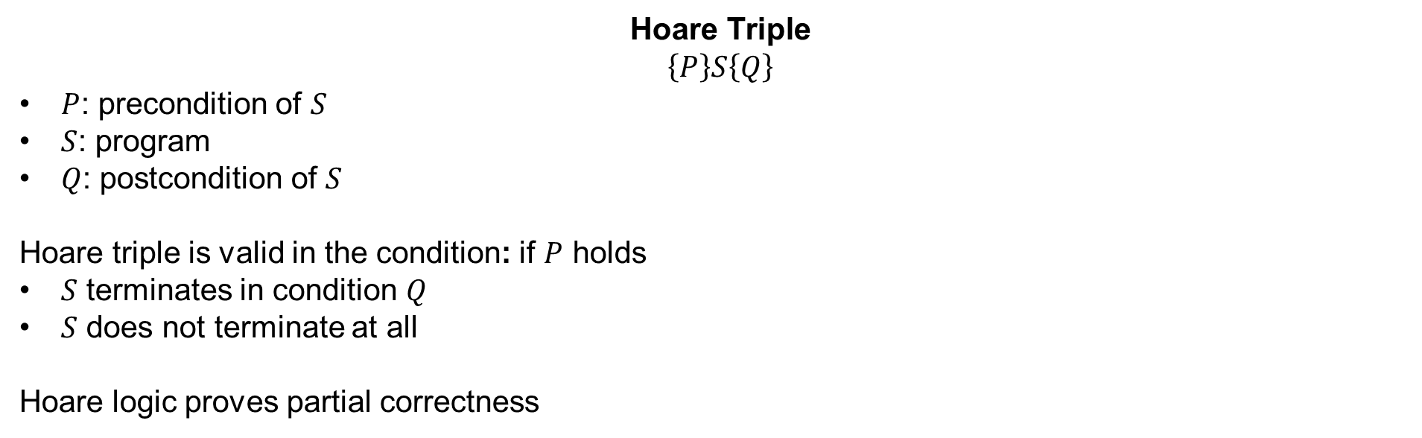
Hoare Logic of Partial Correctness
Hoare Logic: Formal verification method of computer programs
Hoare Triple
$$\left\{P\right\}S\left\{Q\right\}$$
$P$: precondition of $S$
$S$: program
$Q$: postcondition of $S$
Hoare triple is valid in the condition: if $P$ holds
$S$ terminates in condition $Q$
$S$ does not terminate at all
Hoare logic proves partial correctness

Slide 9
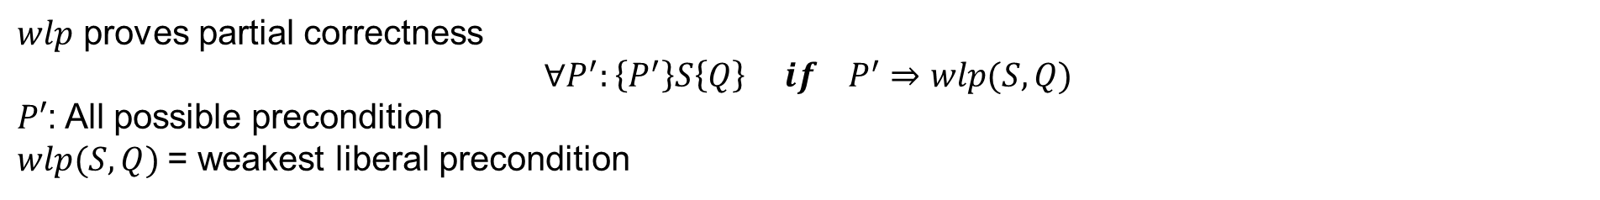
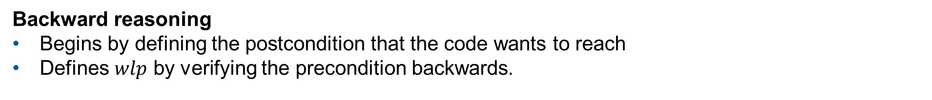
Weakest Liberal Precondition (wlp)
$wlp$ proves partial correctness
$$∀P^{′}:\left\{P^{′}\right\}S\left\{Q\right\} if P^{′}⇒wlp(S,Q)$$
$P′$: All possible precondition $wlp(S,Q)$= weakest liberal precondition
Backward reasoning
Begins by defining the postcondition that the code wants to reach
Defines $wlp$ by verifying the precondition backwards.
$$wlp\left(S1,wlp\left(S2,Q\right)\right) S1 wlp(S1,Q) S2 Q$$

Slide 10

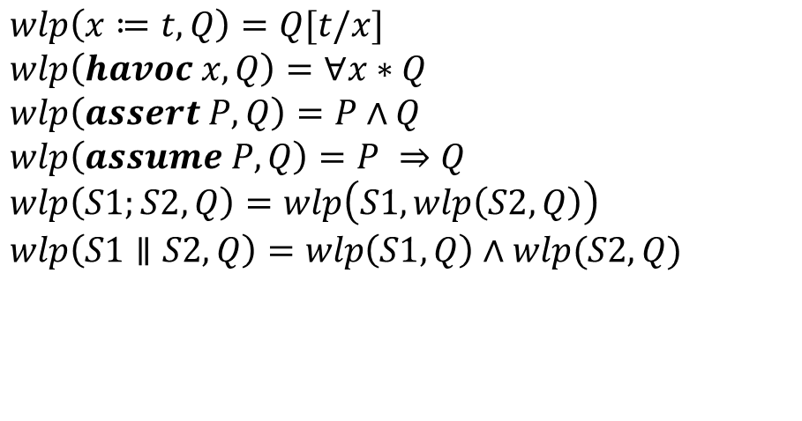
Guarded Commands
Structure of Intermediate verification language summarized by [Mül19]
Basis design of Boogie and HeyVL
Guarded Commands Language
Verification Condition wlp(S,Q)
$S ∷=x≔t$
$$| havoc x$$
$$| assert P$$
$$| assume P$$
$$|S;S$$
$|S∥S$
$$wlp\left(x≔t,Q\right)=Q[t/x]$$
$wlp\left(havoc x,Q\right)=∀x∗Q$
$$wlp\left(assert P, Q\right)=P∧Q$$
$$wlp\left(assume P, Q\right)=P ⇒Q$$
$$wlp\left(S1;S2, Q\right)=wlp\left(S1, wlp\left(S2,Q\right)\right)$$
$wlp\left(S1∥S2,Q\right)=wlp\left(S1,Q\right)∧wlp(S2,Q)$

Slide 11
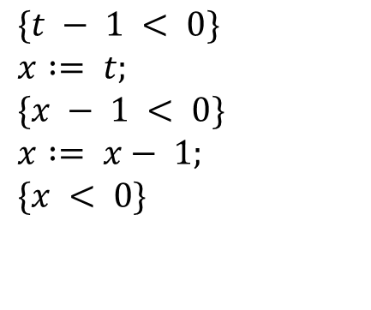

Assignment Rule
$$\left\{P\left[t\backslash x\right]\right\}x≔t\{P\}$$
$$\{t − 1 < 0\}$$
$$x := t;$$
$$\{x − 1 < 0\}$$
$$x := x− 1;$$
$$\{x < 0\}$$

Slide 12
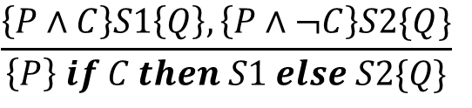
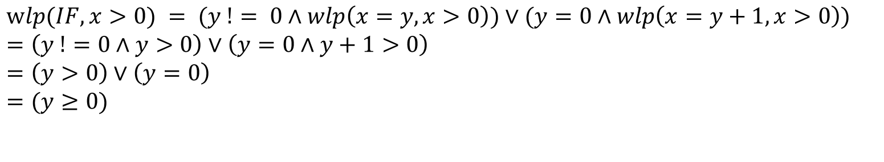
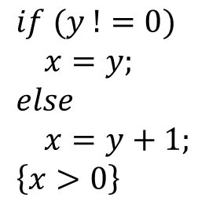
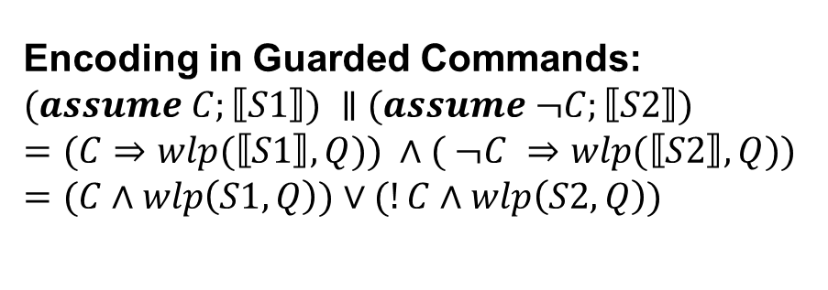
Conditional Statement
$$\frac{\left\{P∧C\right\}S1\left\{Q\right\}, \left\{P∧¬C\right\}S2\{Q\}}{\left\{P\right\} if C then S1 else S2\{Q\}}$$
Encoding in Guarded Commands:
$$(assume C;⟦S1⟧) ∥ (assume ¬C;⟦S2⟧)$$
$$=(C⇒wlp(⟦S1⟧, Q)) ∧( ¬C ⇒wlp(⟦S2⟧, Q))$$
$=(C∧wlp\left(S1, Q\right))∨(!C∧wlp\left(S2,Q\right))$
$$if (y !=0)$$
$$x=y;$$
$$else$$
$$x=y+1;$$
$$\left\{x>0\right\}$$
$$wlp(IF, x>0) = (y != 0∧wlp\left(x=y, x>0\right))∨(y=0∧wlp\left(x=y+1, x>0\right))$$
$$=\left(y !=0∧y>0\right)∨\left(y=0∧y+1>0\right)$$
$$=\left(y>0\right)∨\left(y=0\right)$$
$$=(y≥0)$$

Slide 13
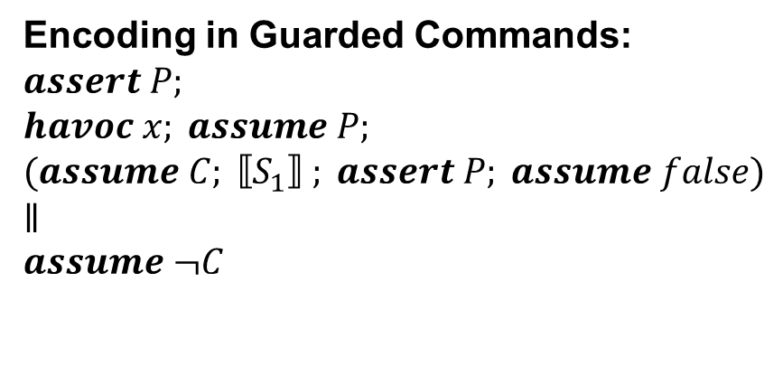
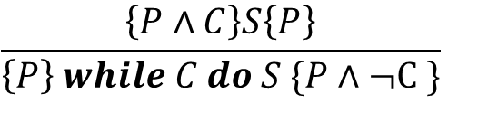
While Statement
$$\frac{\left\{P∧C\right\}S\left\{P\right\}}{\left\{P\right\} while C do S \{P∧¬C \}}$$
Encoding in Guarded Commands:
$$assert P;$$
$$havoc x; assume P;$$
$$(assume C; ⟦S_{1}⟧ ; assert P; assume false)$$
$$∥$$
$$assume ¬C$$
Example of partial correctness:
{true}
while {true} do {false}

Slide 14
Outline
Introduction
Hoare Logic and Guarded Commands
Features of Dafny and Caesar
Comparing Using Algorithms
Discussion and Conclusion

Slide 15
Features of Dafny and Caesar
Dafny | Caesar
Qualitative reasoning | Quantitative and Qualitative reasoning Insert ? for boolean embedding
List Arrays, Sequences, Sets and Multisets | List Built-in Lists
Method Verify algorithms | Procedure Verify algorithms
Function Mathematical functions | Domain Function and axioms Axioms defines function properties
Data type User-defined type | Domain User-defined type

Slide 16
Arrays and Lists
Arrays: Ordered List of elements in Dafny
Lists: Built-in type in Caesar
Comparable with Dafny arrays
//Get element in index 2
var res := arr[2];
//Get length of the array
var res := arr.Length;
//Store element in index 1
arr[1] := 2;
//Get element in index 2
var res = select(arr, 2)
//Get length of the list
var res = len(arr)
//Store element in index 1
var arr = store(arr,1,2)

Slide 17
Multiplication
Dafny
Caesar
method Mul(b:int,e:int) returns (x:int)
requires 0 <= e
ensures x == b*e
{
x := 0;
i := e;
while (0 < i)
invariant x == b*(e-i)
{
x := x + b;
i := i - 1;
}
}
proc Mul(b:Int,e:Int) -> (x:Int)
pre ? (0 <= e)
post ? (x == b*e)
{
x = 0
i = e
assert ? (x == b*(e-i))
havoc x, i
assume ? (x == b*(e-i))
if (0 < i) {
x = x + b
i = i - 1
assert ? (x == b*(e-i))
assume ? (false)
} else {}
}
Guarded Commands of While Statement

Slide 18
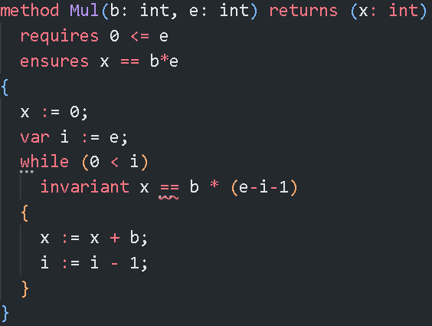
Additional Features in Dafny
Finding Errors
Dafny locates the error automatically
Improves debugging process
Caesar only gives counterexamples

Slide 19
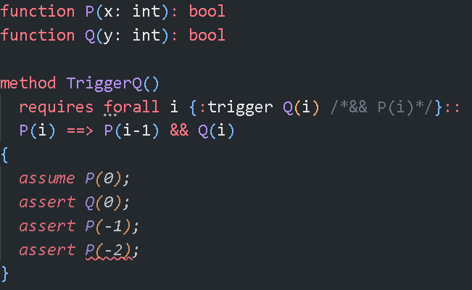
Additional Features in Dafny
Trigger Selection
Manual or Automatic Trigger Selection
Automatic Trigger identifies matching triggers
To avoid loop
Caesar supports Manual Trigger Selection in the future

Slide 20
Outline
Introduction
Hoare Logic and Guarded Commands
Features of Dafny and Caesar
Comparing Using Algorithms
Discussion and Conclusion

Slide 21
Theorem:
Translate Dafny code in Caesar and add ? for boolean embedding of program verification
In the real world:
Verifying the programs is difficult in Caesar as
trigger selection is missing, and it is hard to find errors

Slide 22
Left Pad Function
method LeftPad(str:string, ln:int, c:char) returns (res:string){
if (ln <= |str|) {
res := str;
} else if (|str| < ln) {
var i := 0;
res := str;
while(i < ln - |str|) {
res := [c] + res;
i := i + 1;
}
}
}
„000test“
Add pads to the string

Slide 23
Verification of Left Pad function
„000test“
prefix
suffix
prefix: forall k :: 0 <= k < ln-|str| ==> c == res[k]
suffix: forall k :: max(ln-|str|, 0) <= k < |res| ==> str[k-max(ln-|str|, 0)] == res[k]

Slide 24
Left Pad function in Caesar
Does not support characters
Characters are translated as decimal integers
Does not support string synonym seq<char>
Use built-in Lists
Caesar fails to verify the Left Pad function in built-in Lists
„0001234“
Create a list with
the desired length
Copy the pads and elements into the list

Slide 25
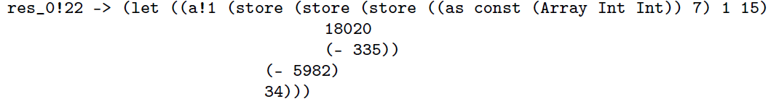
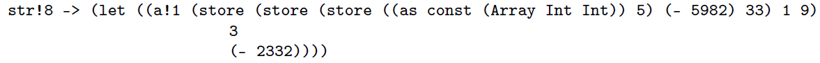
Counterexamples

Slide 26
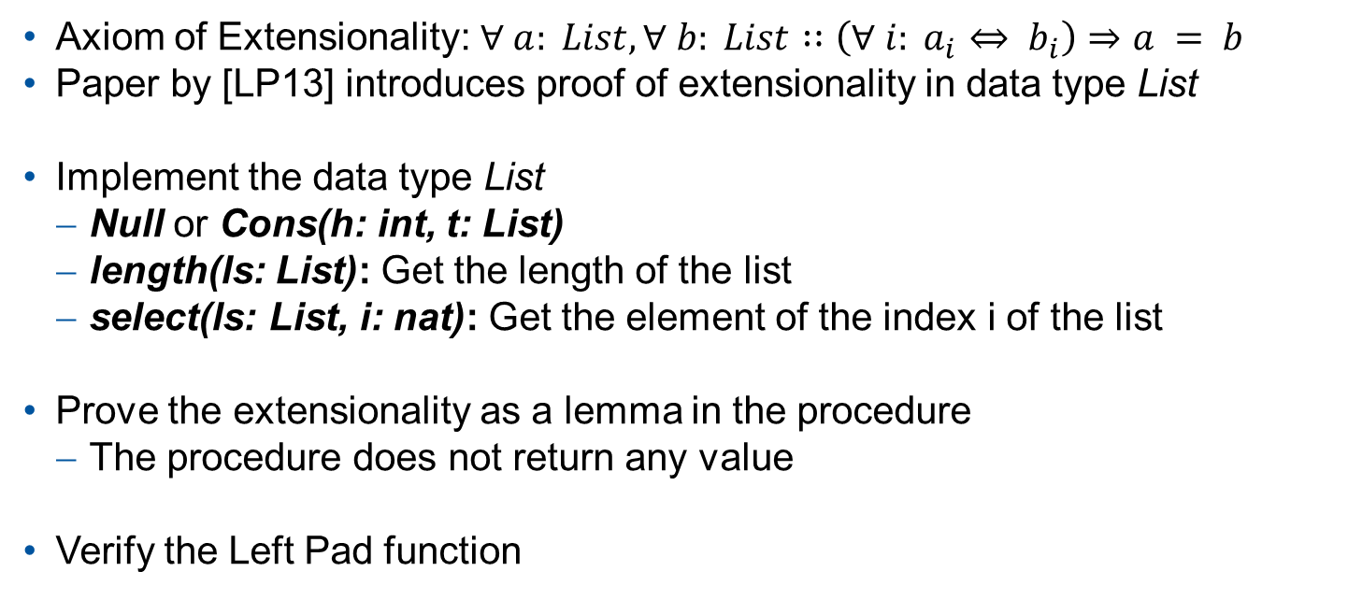
Data type List and Axiom of Extensionality
Axiom of Extensionality: $∀ a: List, ∀ b: List∷\left(∀ i: a_{i}⇔ b_{i}\right)⇒a = b$
Paper by [LP13] introduces proof of extensionality in data type List
Implement the data type List
Null or Cons(h: int, t: List)
length(ls: List): Get the length of the list
select(ls: List, i: nat): Get the element of the index i of the list
Prove the extensionality as a lemma in the procedure
The procedure does not return any value
Verify the Left Pad function
proc Main () -> () {
ls = [0,0,0,1,2,3,4]
res = LeftPad([1,2,3,4], 7, 0)
Extensionality(ls, res)
assert ? (ls = res)
}

Slide 27
Comparing Using Bubble Sort
Bubblesort:
Sort the elements in the list
Swap the values in order
Repeat the process until sorted
3 | 2 | 5 | 1 | 4 | Swap 3,2
2 | 3 | 5 | 1 | 4 | Swap 5,1
2 | 3 | 1 | 5 | 4 | Swap 5,4
2 | 3 | 1 | 4 | 5
2 | 3 | 1 | 4 | 5 | Swap 3,1
2 | 1 | 3 | 4 | 5
2 | 1 | 3 | 4 | 5 | Swap 2,1
1 | 2 | 3 | 4 | 5

Slide 28
Verification of Bubble Sort
Dafny
Type array
Verifies the list is sorted
Use type multiset
Caesar
Built-in type Lists, Data type List
Verifies the list is sorted
Try to implement the function multiplicity
Built-in type Lists can not decide satisfiable or unsatisfiable
Data type List can not verify for all possiblities
[2,4,4,4,3]
Multiplicity of the element 4 is 3

Slide 29
Calling function multiplicity in data type List
ls = [2, 4, 4, 4, 3]
assert ? forall k:: multiplicity(ls, 4) = 3
Caesar verifies the multiplicity of the element 4
ls = [2, 4, 2, 4, 3]
assert ? forall k:: multiplicity(ls, 4) = 2
Caesar could not verify the multiplicity of the element 4
Quantified intances in Caesar is unpredictable

Slide 30
Comparing Using Binary Search Tree
Binary Search Tree:
Sorted binary tree
Element of the left subtree is less than its right subtree
Insert and Deletion
5
3
7
2
4
6
8
1

Slide 31
Verification of Binary Search Tree (BST)
Dafny
Data type Tree
Use type set
Verifies properties of BST
Verifies Insertion and Deletion
Caesar
Data type Tree
Implement function contains
Verifies properties of BST
Verifies Insertion and Deletion

Slide 32
Outline
Introduction
Hoare Logic and Guarded Commands
Features of Dafny and Caesar
Comparing Using Algorithms
Discussion and Conclusion

Slide 33
Discussion
Hard to find errors
Takes a lot of time to find the correct error
Requires investigating all possible errors
Selecting Triggers
Caesar has the problem of implementing quantified expressions
Does not terminate due to its instances

Slide 34
Conclusion
Dafny and Caesar are verification languages
Dafny has additional feature for verification
Find errors and Trigger Selection
Compared Algorithms
Left Pad:
Unable to locate errors in built-in Lists in Caesar
Use the Axiom of Extensionality in the data type List in Caesar
Bubble Sort: Can not verify the multiset in Caesar
Binary Search Tree: Use the function contains in Caesar
Features required in Caesar
Find errors
Automatic Trigger Selection

Slide 35
Thank you for listening!

Slide 36
Set and Multiset
var st_1 : set<int> := {1,1,1,1,2};
var st_2 : set<int> := {1,2};
// Sets are equal.
assert st_1 == st_2;
var ms_1 : multiset<int> := multiset([1, 1, 1, 2]);
var ms_2 : multiset<int> := multiset([1, 2]);
// Multisets are not equal.
assert ms_1 != ms_2;

Slide 37
Dafny Sequences
var sq : seq<int> := [1, 2, 3, 4];
// add number 5
sq := [5] + sq;
assert sq == [5, 1, 2, 3, 4];
// Seq<char>
assert "test" == ['t','e','s','t'];

Slide 38
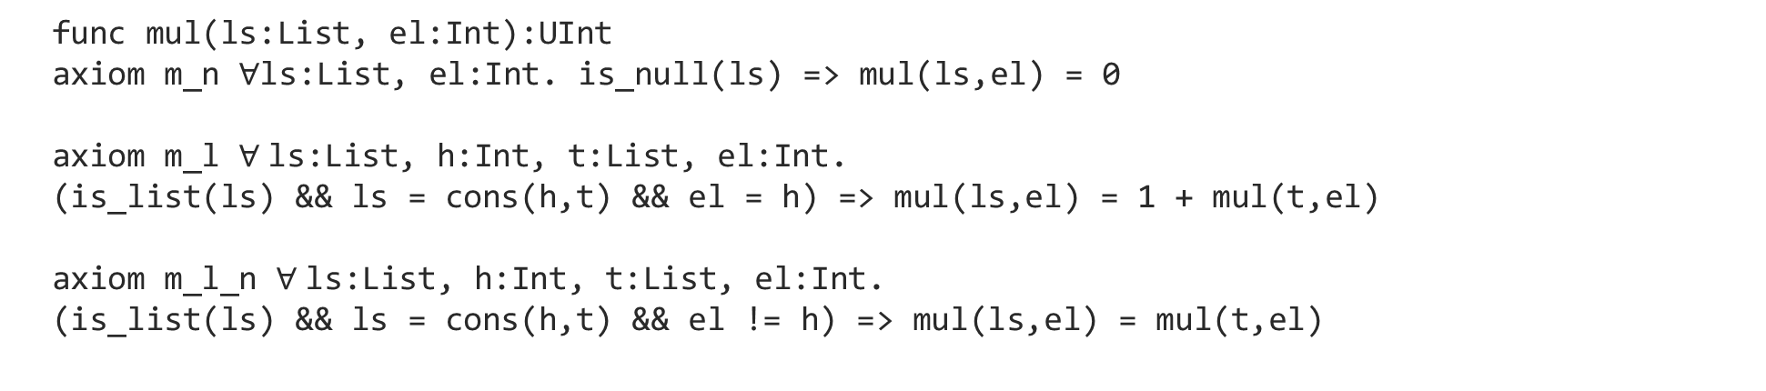
Multiplicity in Caesar
func mul(ls:List, el:Int):UInt
axiom m_n $∀$ls:List, el:Int. is_null(ls) => mul(ls,el) = 0
axiom m_l $∀$ls:List, h:Int, t:List, el:Int.
(is_list(ls) && ls = cons(h,t) && el = h) => mul(ls,el) = 1 + mul(t,el)
axiom m_l_n $∀$ls:List, h:Int, t:List, el:Int.
(is_list(ls) && ls = cons(h,t) && el != h) => mul(ls,el) = mul(t,el)

Slide 39
Contains in Caesar
func contains(t: Tree, val: Int) : Bool
axiom ct_n forall t: Tree, v: Int. is_null(t) => contains(t, v) = false
axiom ct_t_l forall t: Tree, l: Tree, v: Int, r: Tree, val: Int.
(is_tree(t) && t = node(l, v, r) && val < v) => contains(t, val) = contains(l, val)
axiom ct_t_g forall t: Tree, l: Tree, v: Int, r: Tree, val: Int.
(is_tree(t) && t = node(l, v, r) && val > v) => contains(t, val) = contains(r, val)
axiom ct_t_v forall t: Tree, l: Tree, v: Int, r: Tree, val: Int.
(is_tree(t) && t = node(l, v, r) && val = v) => contains(t, val) = true

